Slide 1


Research Study Design I
DEPH 312 Principles of Scientific Evidence
Talal Alshihayb ^{BDS, DScD}
Diplomate, American Board of Dental Public Health
Assistant Professor
Department of Preventive Dental Science, College of Dentistry, King Saud bin Abdulaziz University for Health Sciences
Department of Health Policy and Health Services Research, Henry M. Goldman School of Dental Medicine, Boston University
December 4, 2023
shihaybt@ksau-hs.edu.sa

Slide 2
Recap
How science works
Importance of research
Research questions

Slide 3
Research question/hypothesis/objectives
Research question: major question researcher wants to answer
Specification of study objectives and hypothesis are first step towards formulating approach an approach to answering the research question
Research hypothesis: statements of the answers the researcher expects to find and why (based on previous research or experience)
Study objectives: what researcher wants to do to try answering the research question
Aday LA, Cornelius LJ. Designing and conducting health surveys: a comprehensive guide. John Wiley & Sons; 2006 Apr 14.

Slide 4
Study objectives
In the form of to do
To describe
To predict
To estimate a causal effect
To estimate
To test
To compare
To evaluate
To assess
Etc.
Focus on one research question and its objective/objectives
Too many objectives is not encouraged (ambiguous)
Aday LA, Cornelius LJ. Designing and conducting health surveys: a comprehensive guide. John Wiley & Sons; 2006 Apr 14.

Slide 5

LECTURE LEARNING OUTCOMES OF EACH OF THE DIDACTIC SESSIONS
REFERENCE:
Miguel A. Hernán, John Hsu & Brian Healy (2019) A Second Chance to Get Causal Inference Right: A Classification of Data Science Tasks, CHANCE, 32:1, 42-49, DOI: 10.1080/09332480.2019.1579578
P. 41 in Westreich, Daniel. Epidemiology by Design. Oxford University Press. Kindle Edition
Chapter 1 in Westreich, Daniel. Epidemiology by Design. Oxford University Press. Kindle Edition
Chapters 1 and 2 in Epidemiology an Introduction by Kenneth Rothman
P38-56 of chapter 4 in Epidemiology an Introduction by Kenneth Rothman
Section 1.3 of Chapter 1 in Oral Epidemiology A Textbook on Oral Health Conditions, Research Topics and Methods
LECTURE LEARNING OUTCOMES:
Define epidemiology.
Differentiate between descriptive, predictive, and causal epidemiology.
Differentiate between prevalence and incidence.

Slide 6

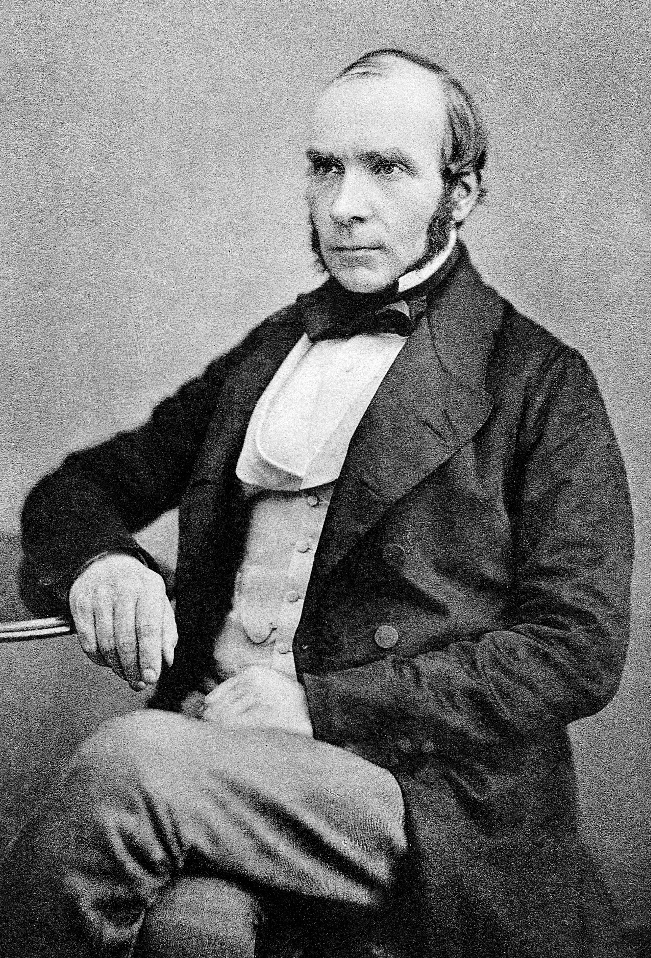
The story of John Snow
https://www.google.com/url?sa=i&url=https%3A%2F%2Fen.wikipedia.org%2Fwiki%2FJon_Snow_%2528character%2529&psig=AOvVaw2FSwPXBW-5F23ZUU8m965r&ust=1670254619246000&source=images&cd=vfe&ved=0CBAQjRxqFwoTCODkmL2l4PsCFQAAAAAdAAAAABAK
https://www.google.com/url?sa=i&url=https%3A%2F%2Fen.wikipedia.org%2Fwiki%2FJohn_Snow&psig=AOvVaw2FSwPXBW-5F23ZUU8m965r&ust=1670254619246000&source=images&cd=vfe&ved=0CBAQjRxqFwoTCODkmL2l4PsCFQAAAAAdAAAAABAE
Notes:
Mid 19th century a disease spread all over London and killed a lot of people
Unknown
John snow suspected that water was the source
Deaths were higher in districts where the disease spread
The regions were disease spread and deaths were high were served by two water companies (Southward and Vauxhall and Lambeth)
Both companies picked water from sewage
Lambeth company changed the source of water
Districts supplied by Lambeth has fewer deaths than ones supplied by the other company

Slide 7
Discoveries in Medicine
John Snow (Cholera)
James Lind (Scurvy)
Others

Slide 8
Epidemiology
“Epidemiology is largely concerned with the study of the presence and occurrence of disease and ways to prevent disease and maintain health.”
Westreich, Daniel. Epidemiology by Design (p. 7). Oxford University Press. Kindle Edition

Slide 9
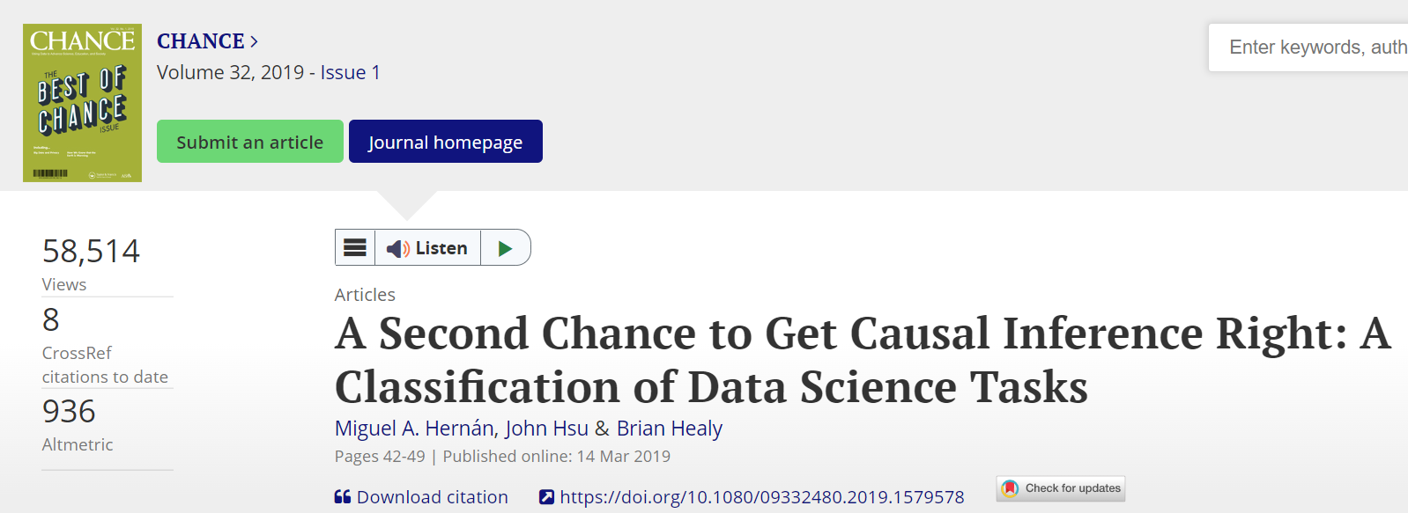

Slide 10
The different research/study tasks
Descriptive
Predictive (factual prediction)
Causal (counterfactual prediction)
Hernán MA, Hsu J, Healy B. A second chance to get causal inference right: a classification of data science tasks. Chance. 2019 Jan 2;32(1):42-9.

Slide 11
Epidemiological tasks/paradigms
Descriptive epidemiology
Predictive epidemiology
Causal epidemiology

Slide 12
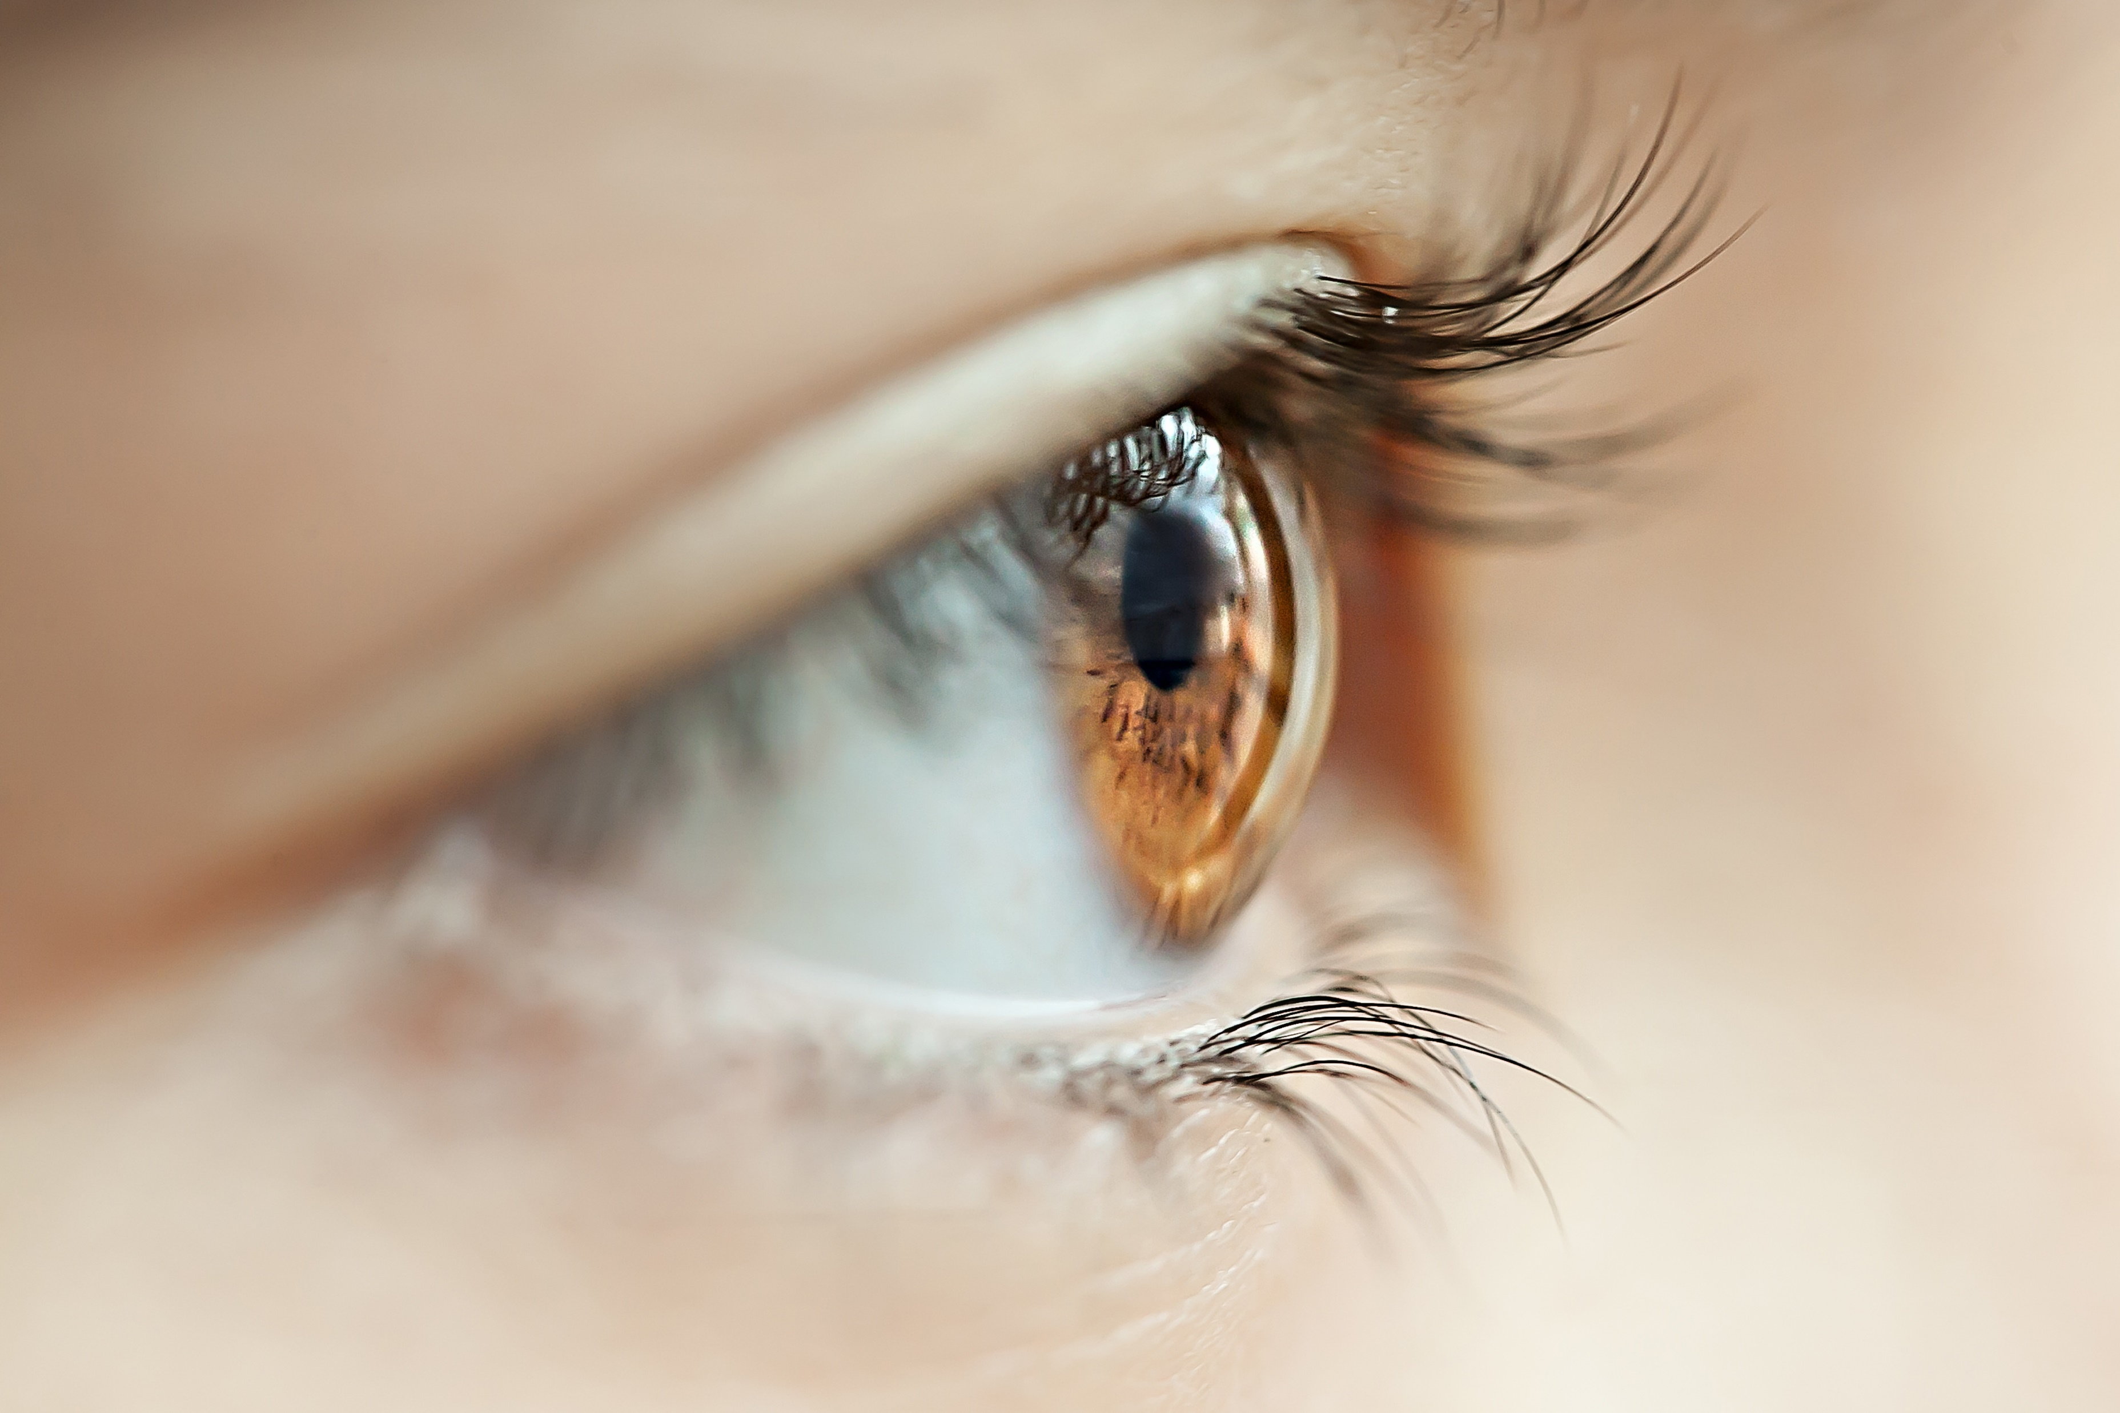
Descriptive Epidemiology
Identify
The extent of disease
The burden of disease
Reporting measures of disease occurrence
Often the first stage

Slide 13
Descriptive Epidemiology
Examples of research questions
What is the percentage of Saudis with dental caries now?
Among all Saudis?
Among males and females?
By region?
What is the percentage of Saudis who develop dental caries in 5 years?
Among all Saudis?
Among males and females?
By region?

Slide 14
Descriptive Epidemiology
Communicating observed world
Identify how large the public health problem is
Helps in setting priorities

Slide 15

Predictive Epidemiology
Identify who is at risk of the disease or how their disease progress over time
Future disease burden (Helps in setting priorities)
Reporting model performance measures
Often the second stage

Slide 16
Predictive Epidemiology
Example of research questions:
Who will get dental caries in Saudi Arabia in the next 5 years?
Types:
Diagnostics (If you have these characteristics, how likely are you to have a disease, which cannot be directly observed?)
If you are a male, aged 30 years, non-smoker, how likely are you to have dental caries now?
Prognostics (If you have these characteristics, how likely are you to develop a disease, which cannot be directly observed?)
If you are a male, aged 30 years, non-smoker, how likely are you to have dental caries in the next 5 years?
If you are a male, aged 30 years, non-smoker, and have dental caries, how likely is your caries to progress in the next 5 years?

Slide 17
Predictive Epidemiology
Does not help you on knowing what to intervene on to prevent the disease

Slide 18

Causal Epidemiology
Identify
Causes
Which factors are the strongest causes of a disease
Focus is on a single variable (exposure/intervention)
Helps you on knowing what to intervene on to prevent the outcome
Reporting measures of association
Often the third stage (after identifying the extend of disease and who is at higher risk for disease)

Slide 19
Causal Epidemiology
Examples of research questions:
Would I get dental caries had I not eaten sugars?
What is the effect of eating sugars compared to eating no sugars on getting dental caries after 1 year?
Compare what actually happened to what would have happened, counter to fact, had the exposure been different

Slide 20
 | Descriptive | Predictive | Causal
Identifies | The extent of the disease | Who are at higher risk to have the disease | The reason for having the disease
Reports | Measure of disease occurrence | Model performance | Measure of association
Stage | First | Second | Third
Asks | How spread is the problem | Who is at higher risk to have the disease now? To have the disease in the future? to have disease progress? | Would I have gotten lung cancer had I not smoked?
Helps in | Setting priorities (deciding which disease to pay attention to) | Setting priorities (deciding who to target with an intervention on a certain disease) | Figure out what to intervene on to prevent disease or its progress

Slide 21
Let’s practice

Slide 22
Diabetes is spread in Saudi Arabia and we need to do something about it, but we do not have enough money to prevent it on the whole population. Instead we want to target Saudis who are at highest risk for developing diabetes. Therefore, we conduct a study to identify them.
This is:
Descriptive?
Predictive?
Causal?
Notes:
Predictive

Slide 23
A new disease has emerged in Saudi Arabia and the Ministry of Health would like to know how frequent this disease is. Therefore, you conduct a study to know it.
This is:
Descriptive?
Predictive?
Causal?
Notes:
Descriptive

Slide 24
The NGHA has informed you that dental caries is very high among NGHA population and asked you to do something about it to prevent it. Therefore, you conduct a study to address this issue.
This is:
Descriptive?
Predictive?
Causal?
Notes:
Causal

Slide 25
A company has asked you to check if their male employees have higher/lower/same stress as their female employees. Therefore, you conduct a study to know it.
This is:
Descriptive?
Predictive?
Causal?
Notes:
Descriptive

Slide 26
The dean has asked you to develop a program that can check if a patient has a caries given his/her chief complaint, gender, and age. Therefore, you conduct a study to meet his expectation.
This is:
Descriptive?
Predictive?
Causal?
Notes:
Predicive

Slide 27
You want to know how many KSAUHS COD students smoked last year. You conduct a study to calculate this.
This is:
Descriptive?
Predictive?
Causal?
Notes:
Descriptive

Slide 28
A new policy took place at KSAUHS COD regarding missing appointments where if a patient misses his/her appointment 2 times without a reason, his/her file would be cancelled. You would like to know the impact of this policy on no shows.
This is:
Descriptive?
Predictive?
Causal?
Notes:
Causal

Slide 29
A social media company has asked you to identify who is likely to press on their platform advertisements in the next 2 weeks. You conduct a study to know the information.
This is:
Descriptive?
Predictive?
Causal?
Notes:
Predictive

Slide 30
You want to know which restorative material has better effectiveness in terms of 1 year survival (survives more after 1 year). You conduct a study to know this.
This is:
Descriptive?
Predictive?
Causal?
Notes:
Causal

Slide 31
Framing a research question for a descriptive study
Population
Strata/groups (not necessary)
Outcome
Time frame
Could be framed in terms:
Place
Person
Time
Without strata/group
E.g., among people aged 30 and older in Saudi Arabia, what is the prevalence of diabetes in the year 2022?
With strata/group
E.g., among people aged 30 and older in Saudi Arabia, what is the prevalence of diabetes in the year 2022 by gender?
Wrong question bias. Society for Epidemiologic Research, 2020

Slide 32
Framing a research question for a causal study
Population
Intervention
Comparison groups
Outcome
Time frame
E.g., among Saudis aged 30 and older who are diagnosed with stage I oral squamous cell carcinoma, what is the difference in 5-year survival between those who receive radiotherapy and those who do not receive radiotherapy?
E.g., among Saudis aged 30 and older who are diagnosed with stage I oral squamous cell carcinoma, what is the effect of receiving radiotherapy on 5-year survival compared to not receiving radiotherapy?
Wrong question bias. Society for Epidemiologic Research, 2020

Slide 33






Beware of risk factor epidemiology
All variables in a single model and compare between them in terms of how they affect an outcome

Slide 34
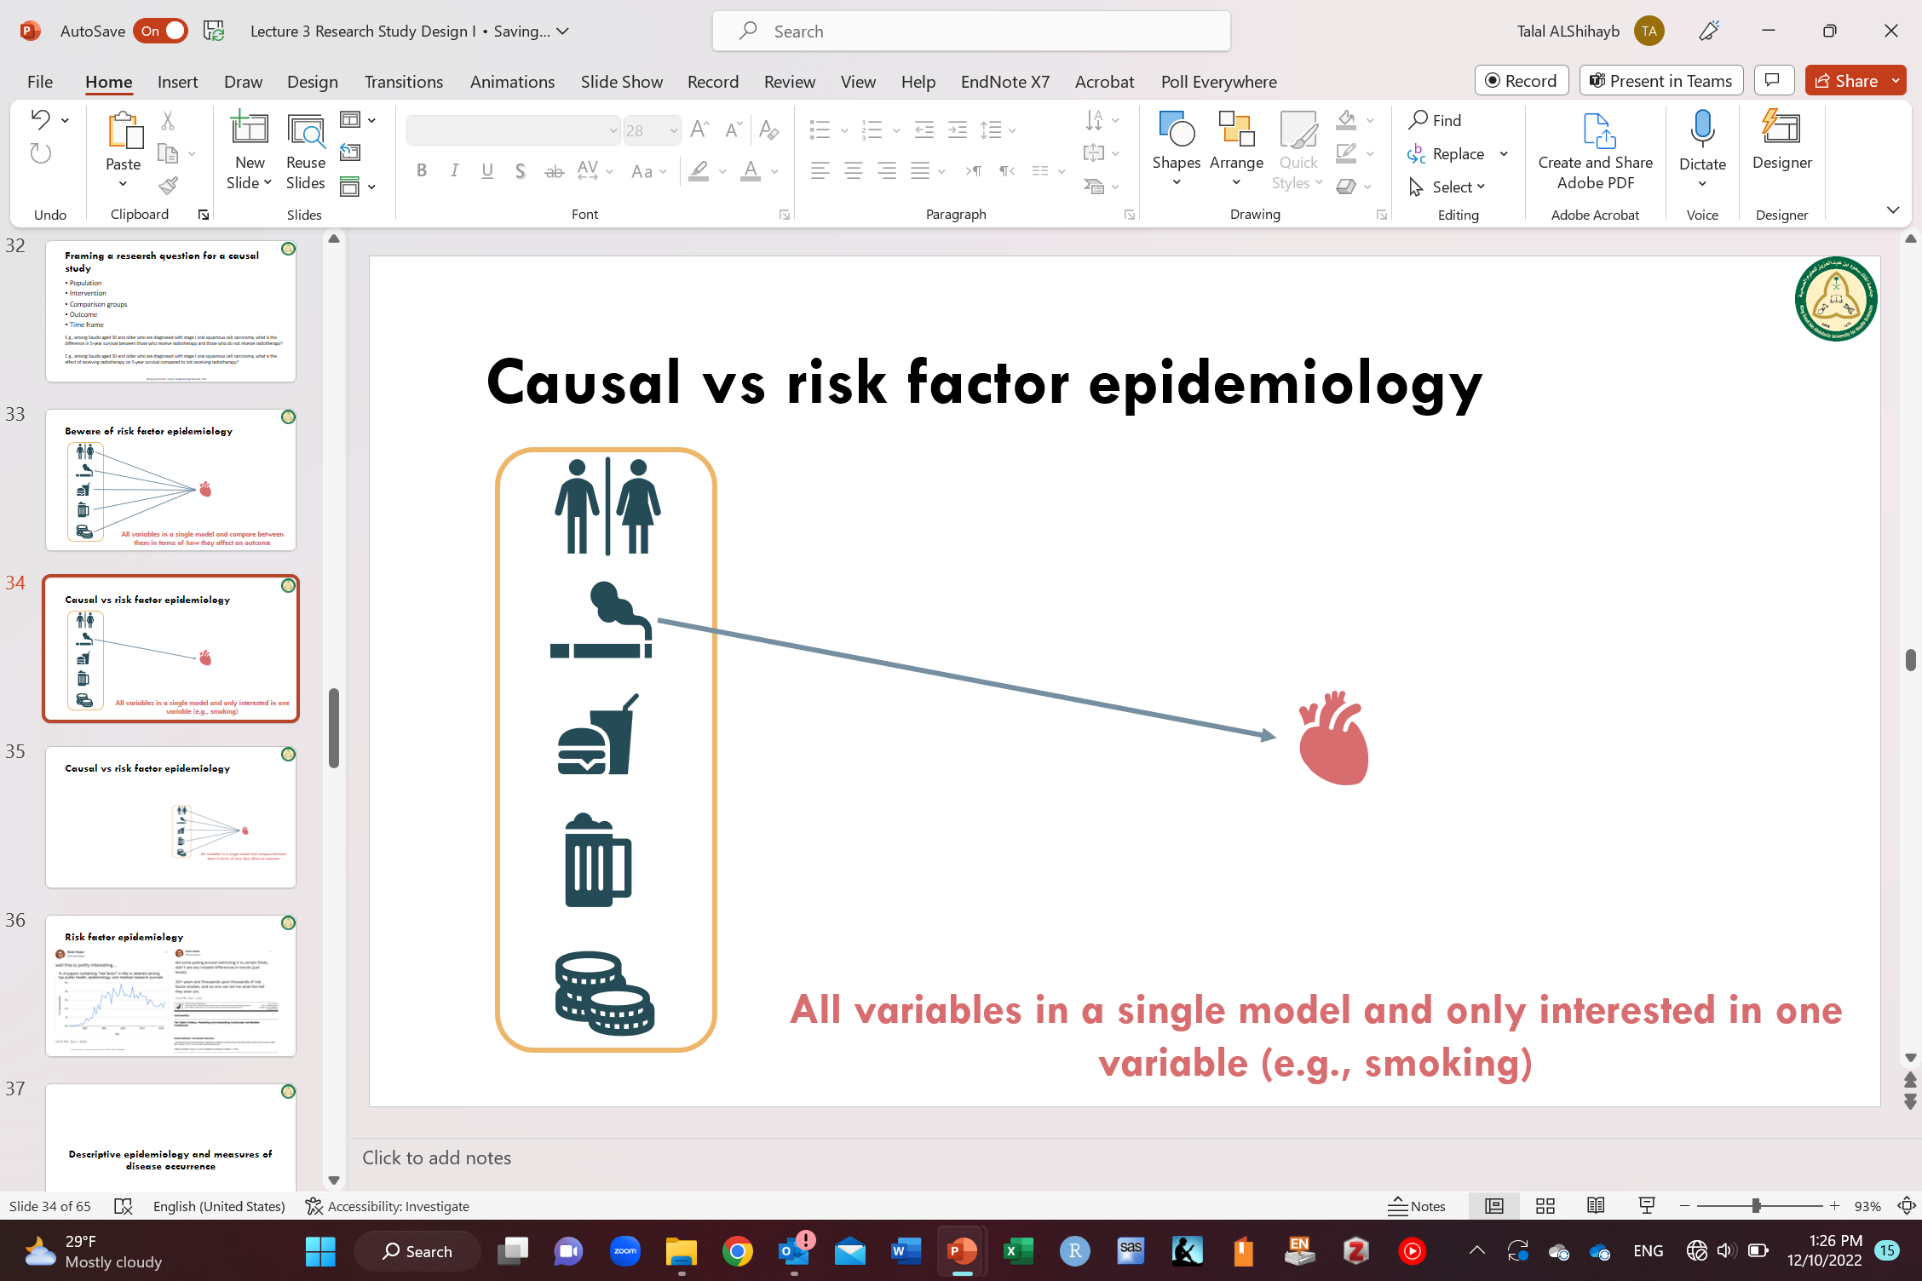
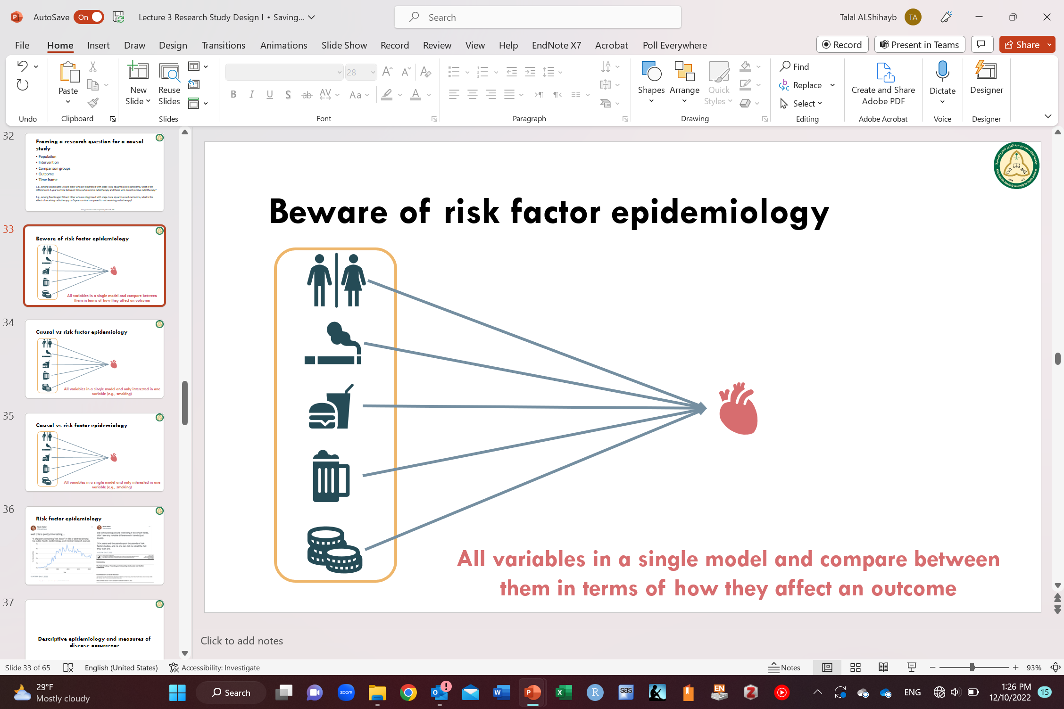
Causal vs risk factor epidemiology
Causal epidemiology
Risk factor epidemiology
Clear goal
Interest in the effect of a single variable
Only the variable of interest can be interpreted causally (with some assumptions)
Ambiguous goal
Interest in all variables in the model
Not all variable can be interpreted causally

Slide 35
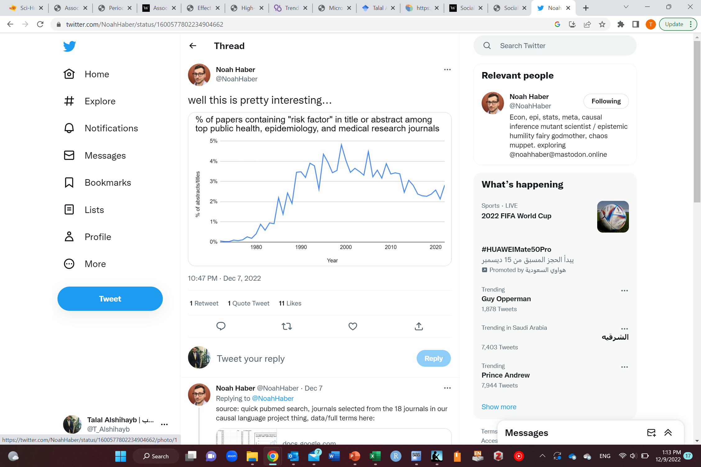
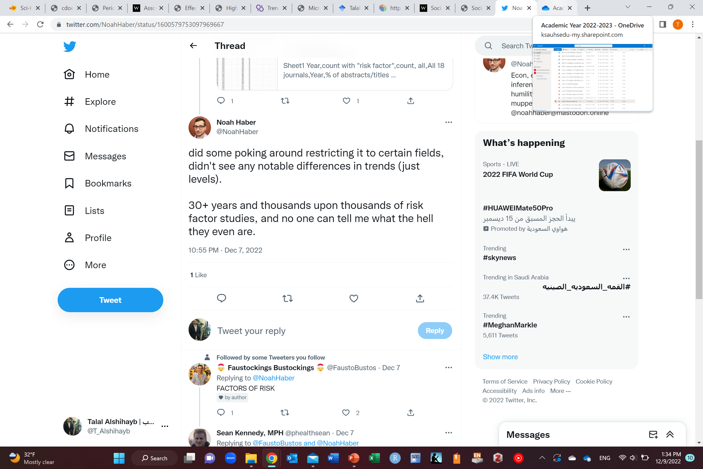
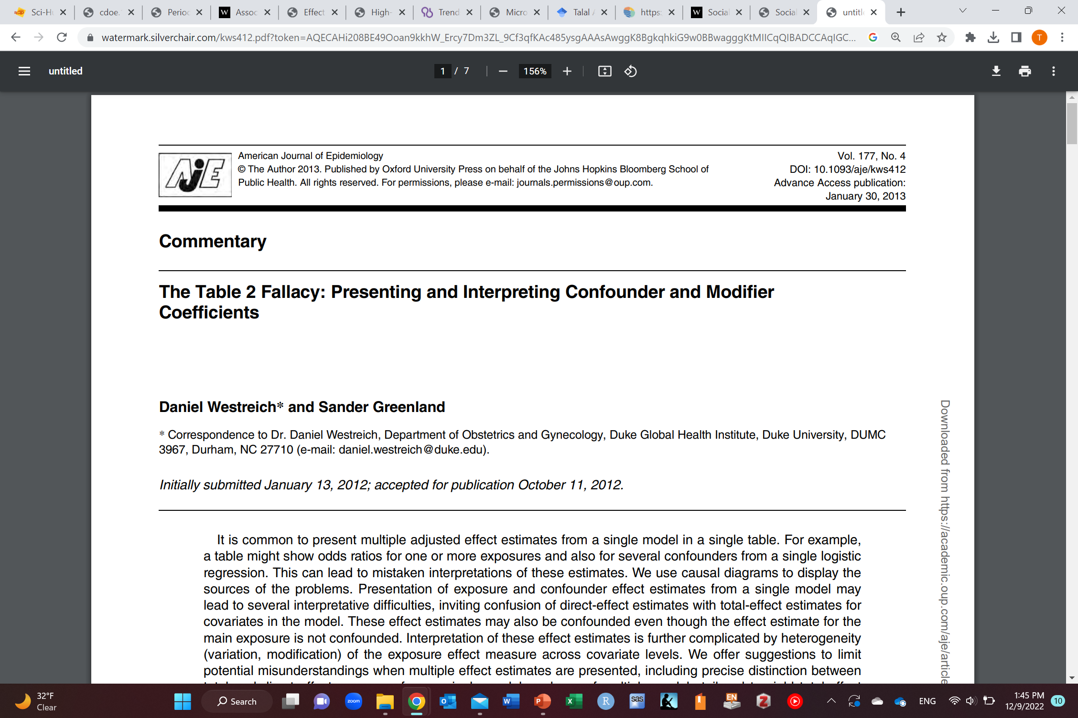
Beware of risk factor epidemiology
https://twitter.com/NoahHaber/status/1600577802234904662

Slide 36
Descriptive epidemiology and measures of disease occurrence

Slide 37
Measures of disease occurrence
Prevalence (presence or absence of disease in a population)
Proportion/rate (used mostly)
Odds
Counts
Incidence (how many new cases of disease occur over a time period)
Proportion (risk; cumulative incidence)
Odds
Counts
Rate (not a proportion; incidence density)
Time to event

Slide 38
Measures of disease occurrence
Prevalence (presence or absence of disease in a population)
Proportion/rate (used mostly)
Odds
Counts (no denominator but context dependent and is known; think COVID)

Slide 39


Measures of disease occurrence
Prevalence (presence or absence of disease in a population)
$$Prevalence proportion(p)=\frac{How many presently have disease or history of disease of a specified duration}{present total population}$$
Ranges between 0 to 1 (probability)
Prevalence of disease in population
12/32=0.375=37.5%

Slide 40
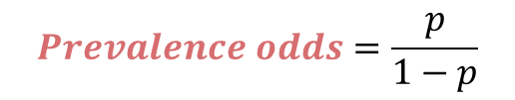
Measures of disease occurrence
Prevalence (presence or absence of disease in a population)
$$Prevalence odds=\frac{p}{1−p}$$
Ranges between 0 to infinity (not a probability)
Prevalence odds of disease in population=12/20=0.6

Slide 41
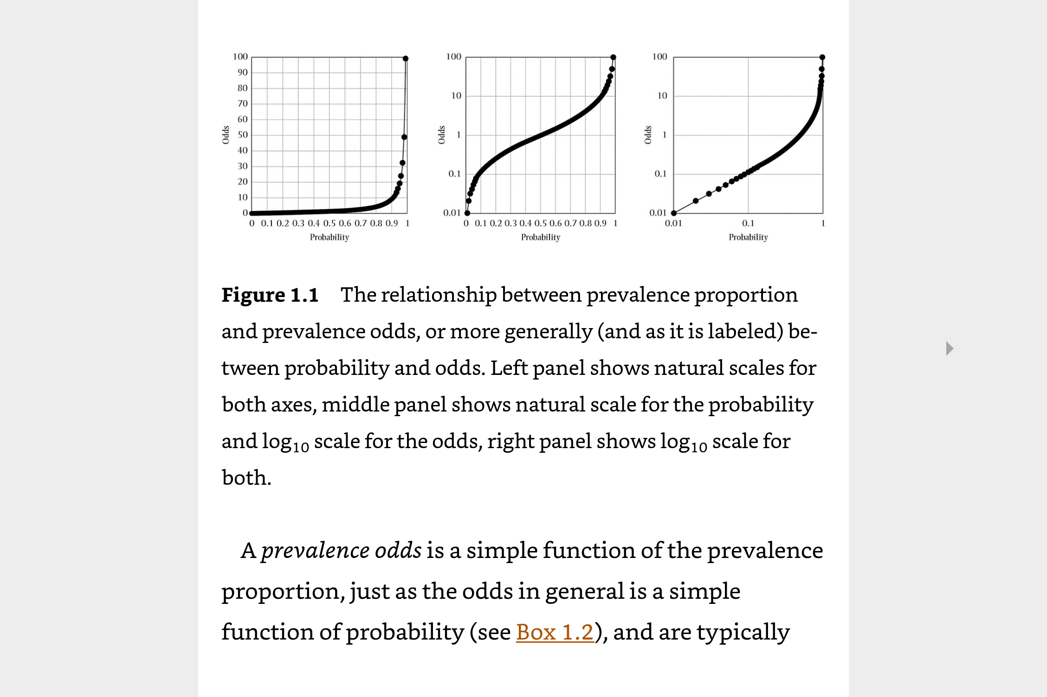
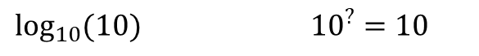
$\log_{10}{(10})$ ${10}^{?}=10$
10 on natural scale corresponds to 1 on $\log_{10}$ scale
Westreich D. Epidemiology by design: a causal approach to the health sciences. Oxford University Press; 2019 Oct 16.

Slide 42
 | P | Odds
Approximated | 0.05 | 0.05/0.95=0.053
 | 0.06 | 0.06/0.94=0.064
 | 0.10 | 0.10/0.90=0.111
Overestimated | 0.11 | 0.11/0.89=0.124
Overestimated | 0.12 | 0.12/0.88=0.136
 | 0.13 | 0.13/0.87=0.149
 | 0.14 | 0.14/0.86=0.163
 | 0.15 | 0.15/0.85=0.176
 | 0.16 | 0.16/0.84=0.190
 | 0.17 | 0.17/0.83=0.205
 | 0.20 | 0.20/0.80=0.250

Slide 43
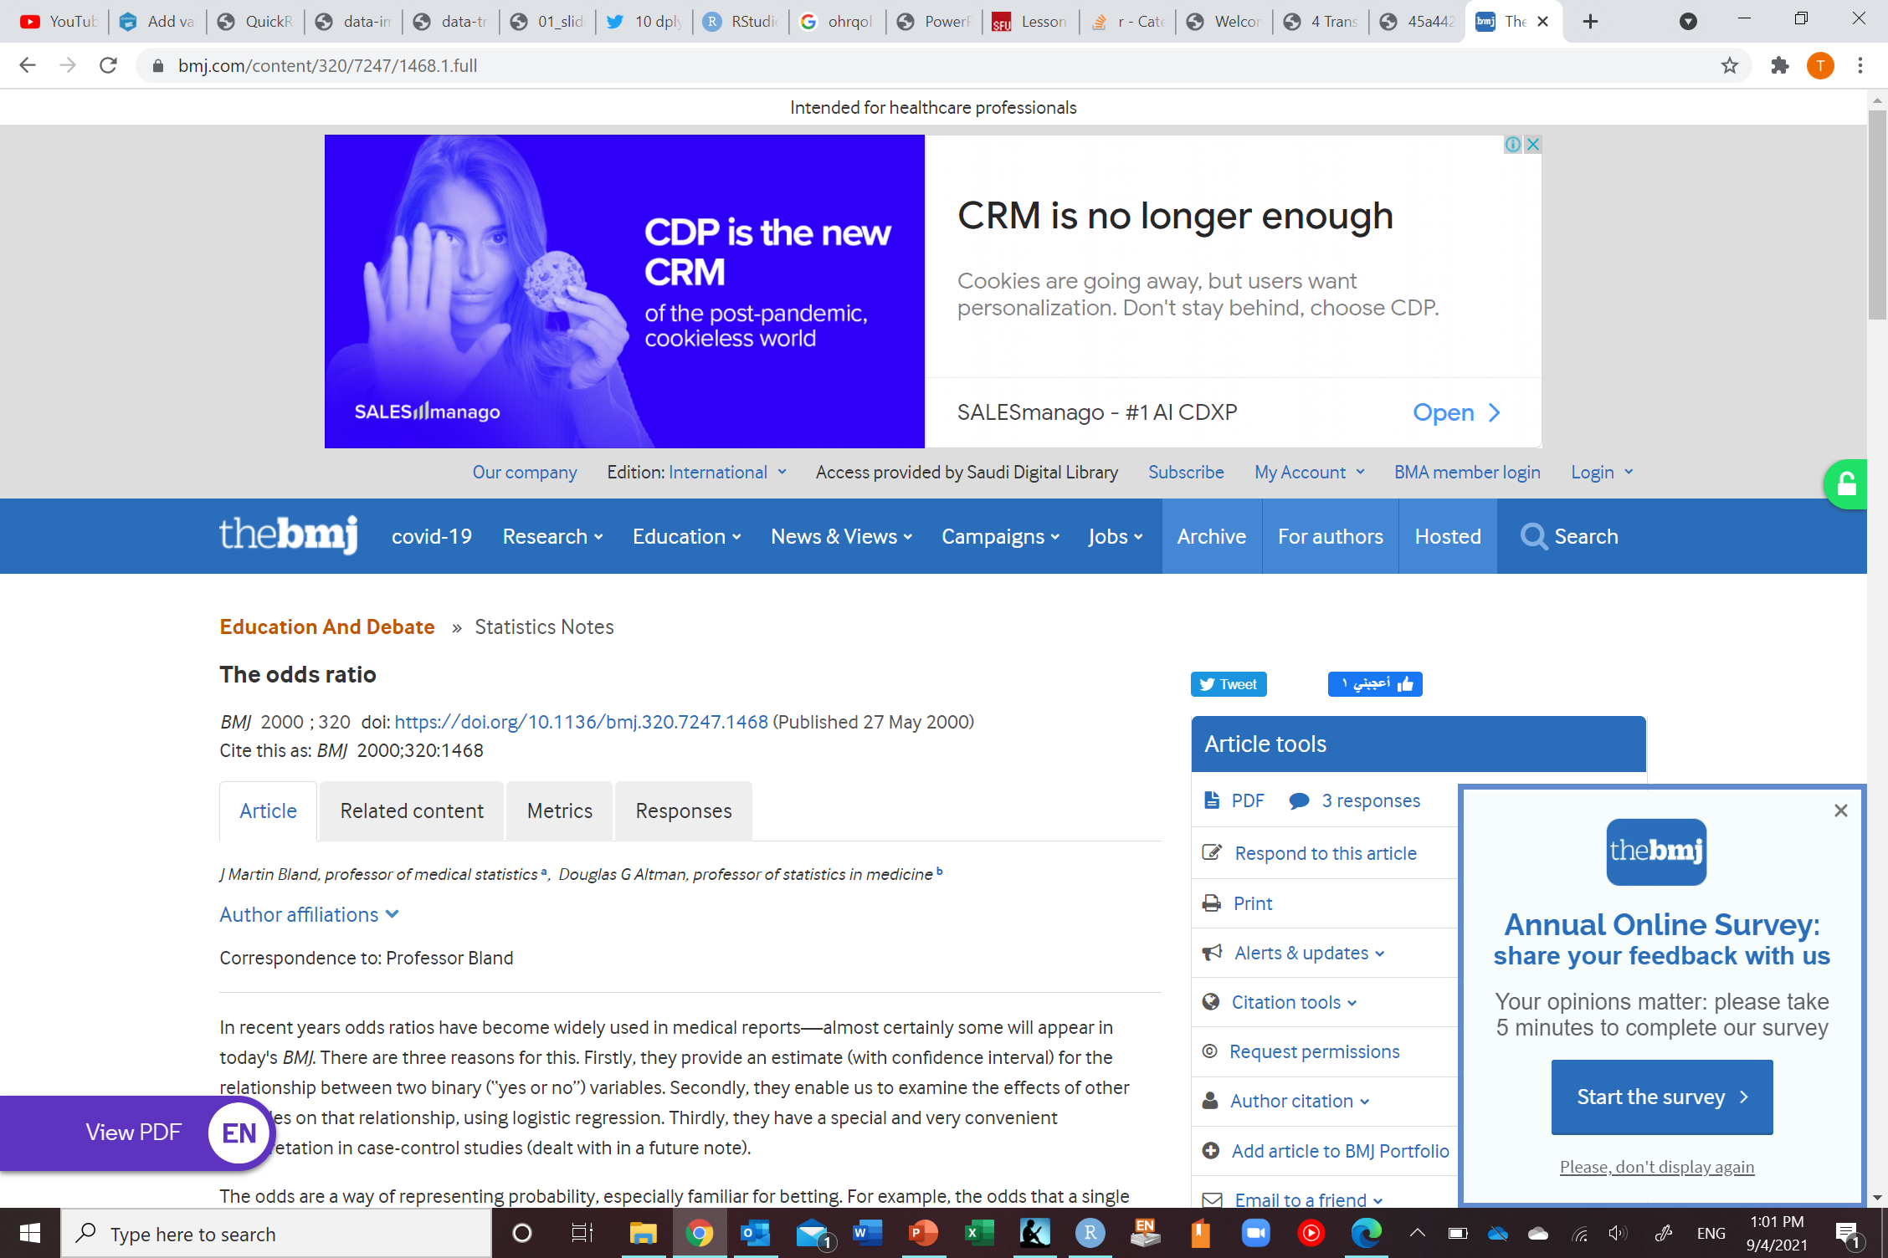
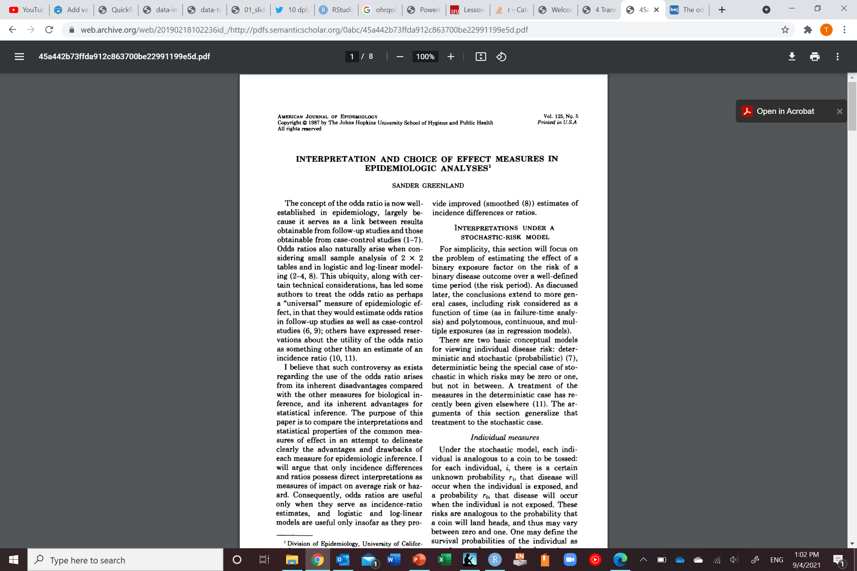
Why odds?
Convenient in gambling
Easier to estimate (default output in some statistical programs)
Have convenient statistical properties

Slide 44
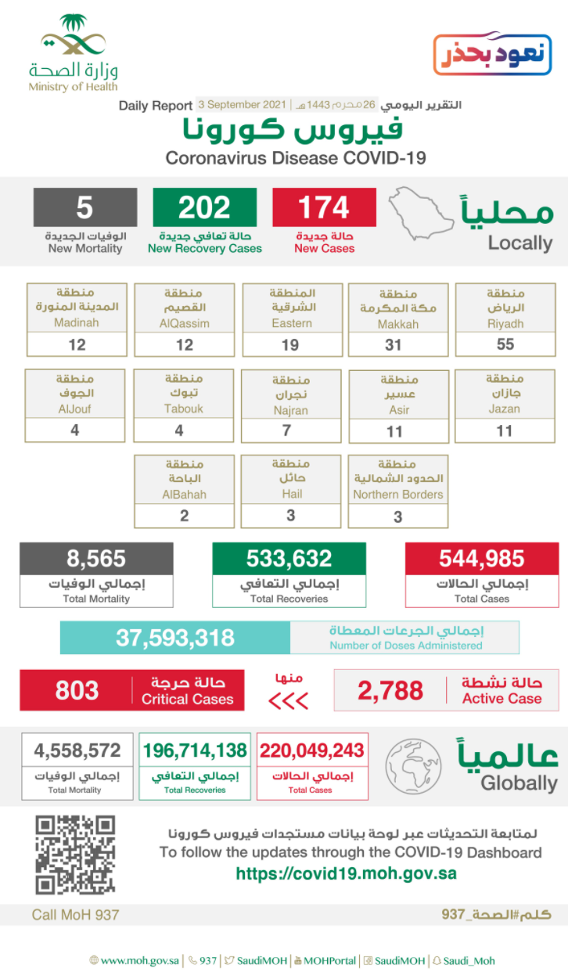
Measures of disease occurrence
Prevalence (presence or absence of disease in
a population)
Counts (no denominator but context dependent and is known; think COVID)
12

Slide 45
Measures of disease occurrence
Incidence (how many new cases of disease occur over a time period)
Proportion (risk; cumulative incidence)
Rate (not a proportion; incidence density)
Time to event
Odds
Counts
Only
Baseline
Time 0

Slide 46
Let’s talk about survival first

Slide 47
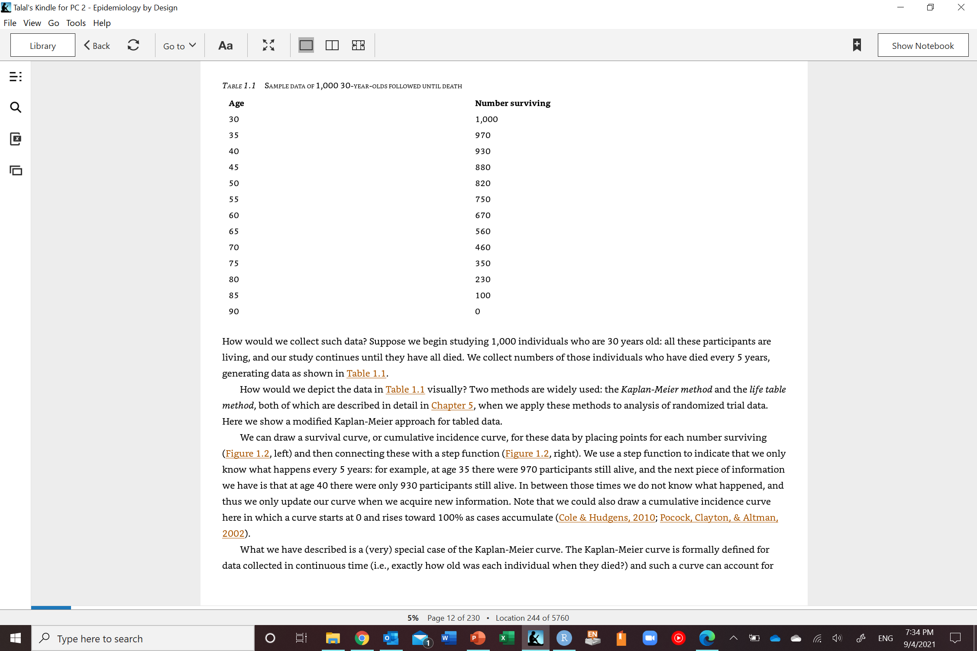
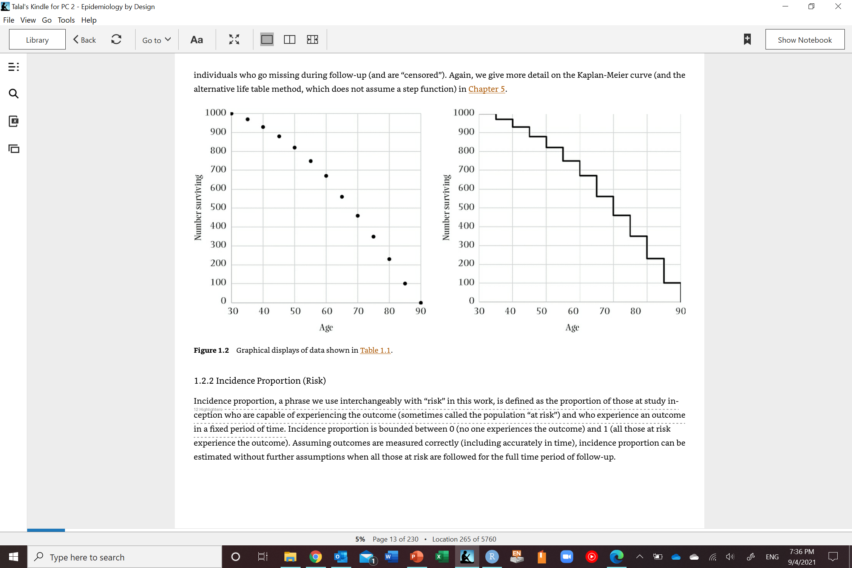
Survival curves
30 people died
40 people died
Westreich D. Epidemiology by design: a causal approach to the health sciences. Oxford University Press; 2019 Oct 16.

Slide 48
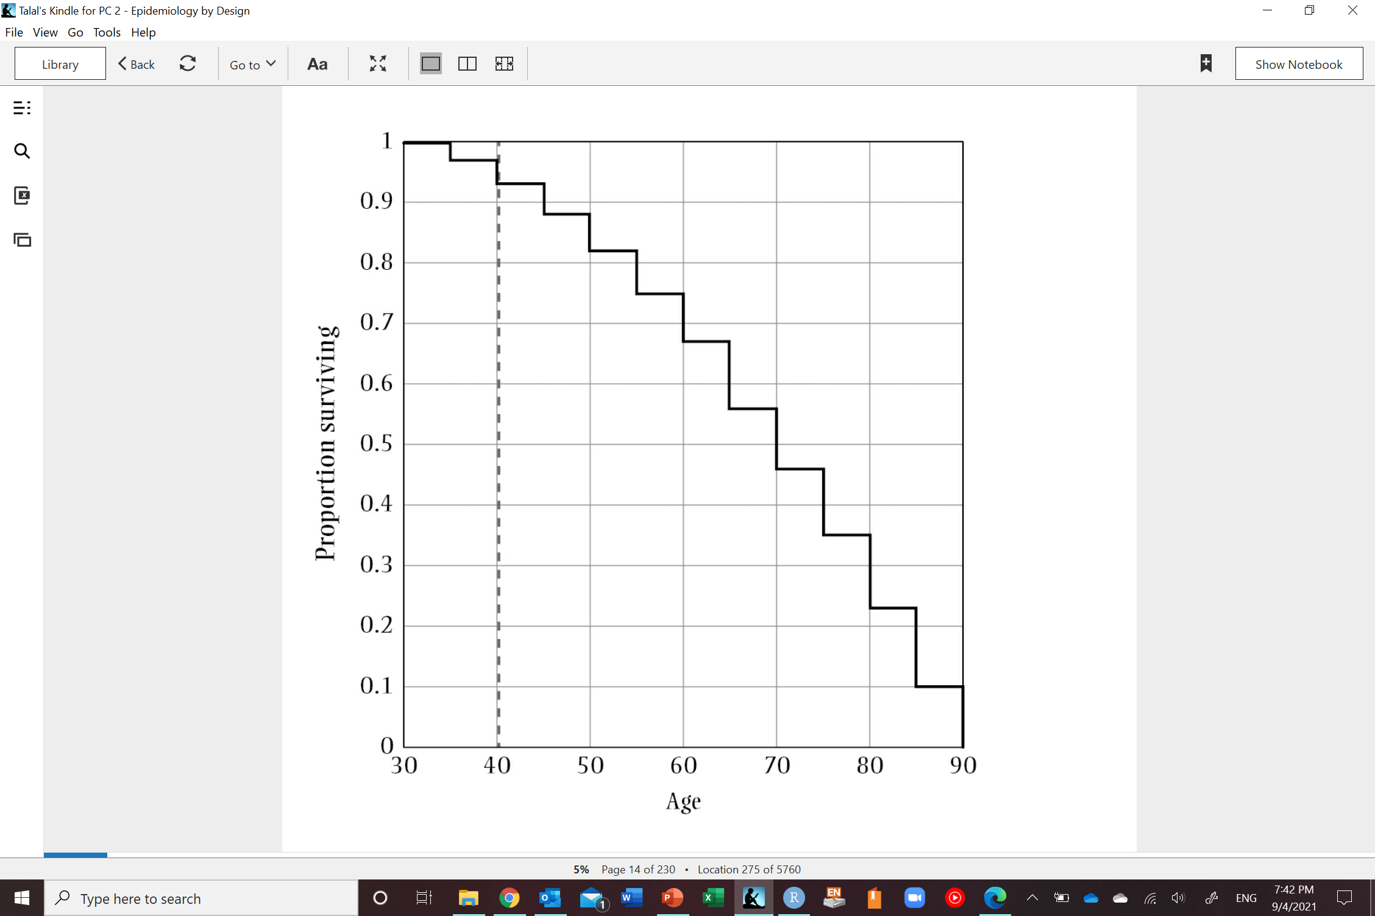
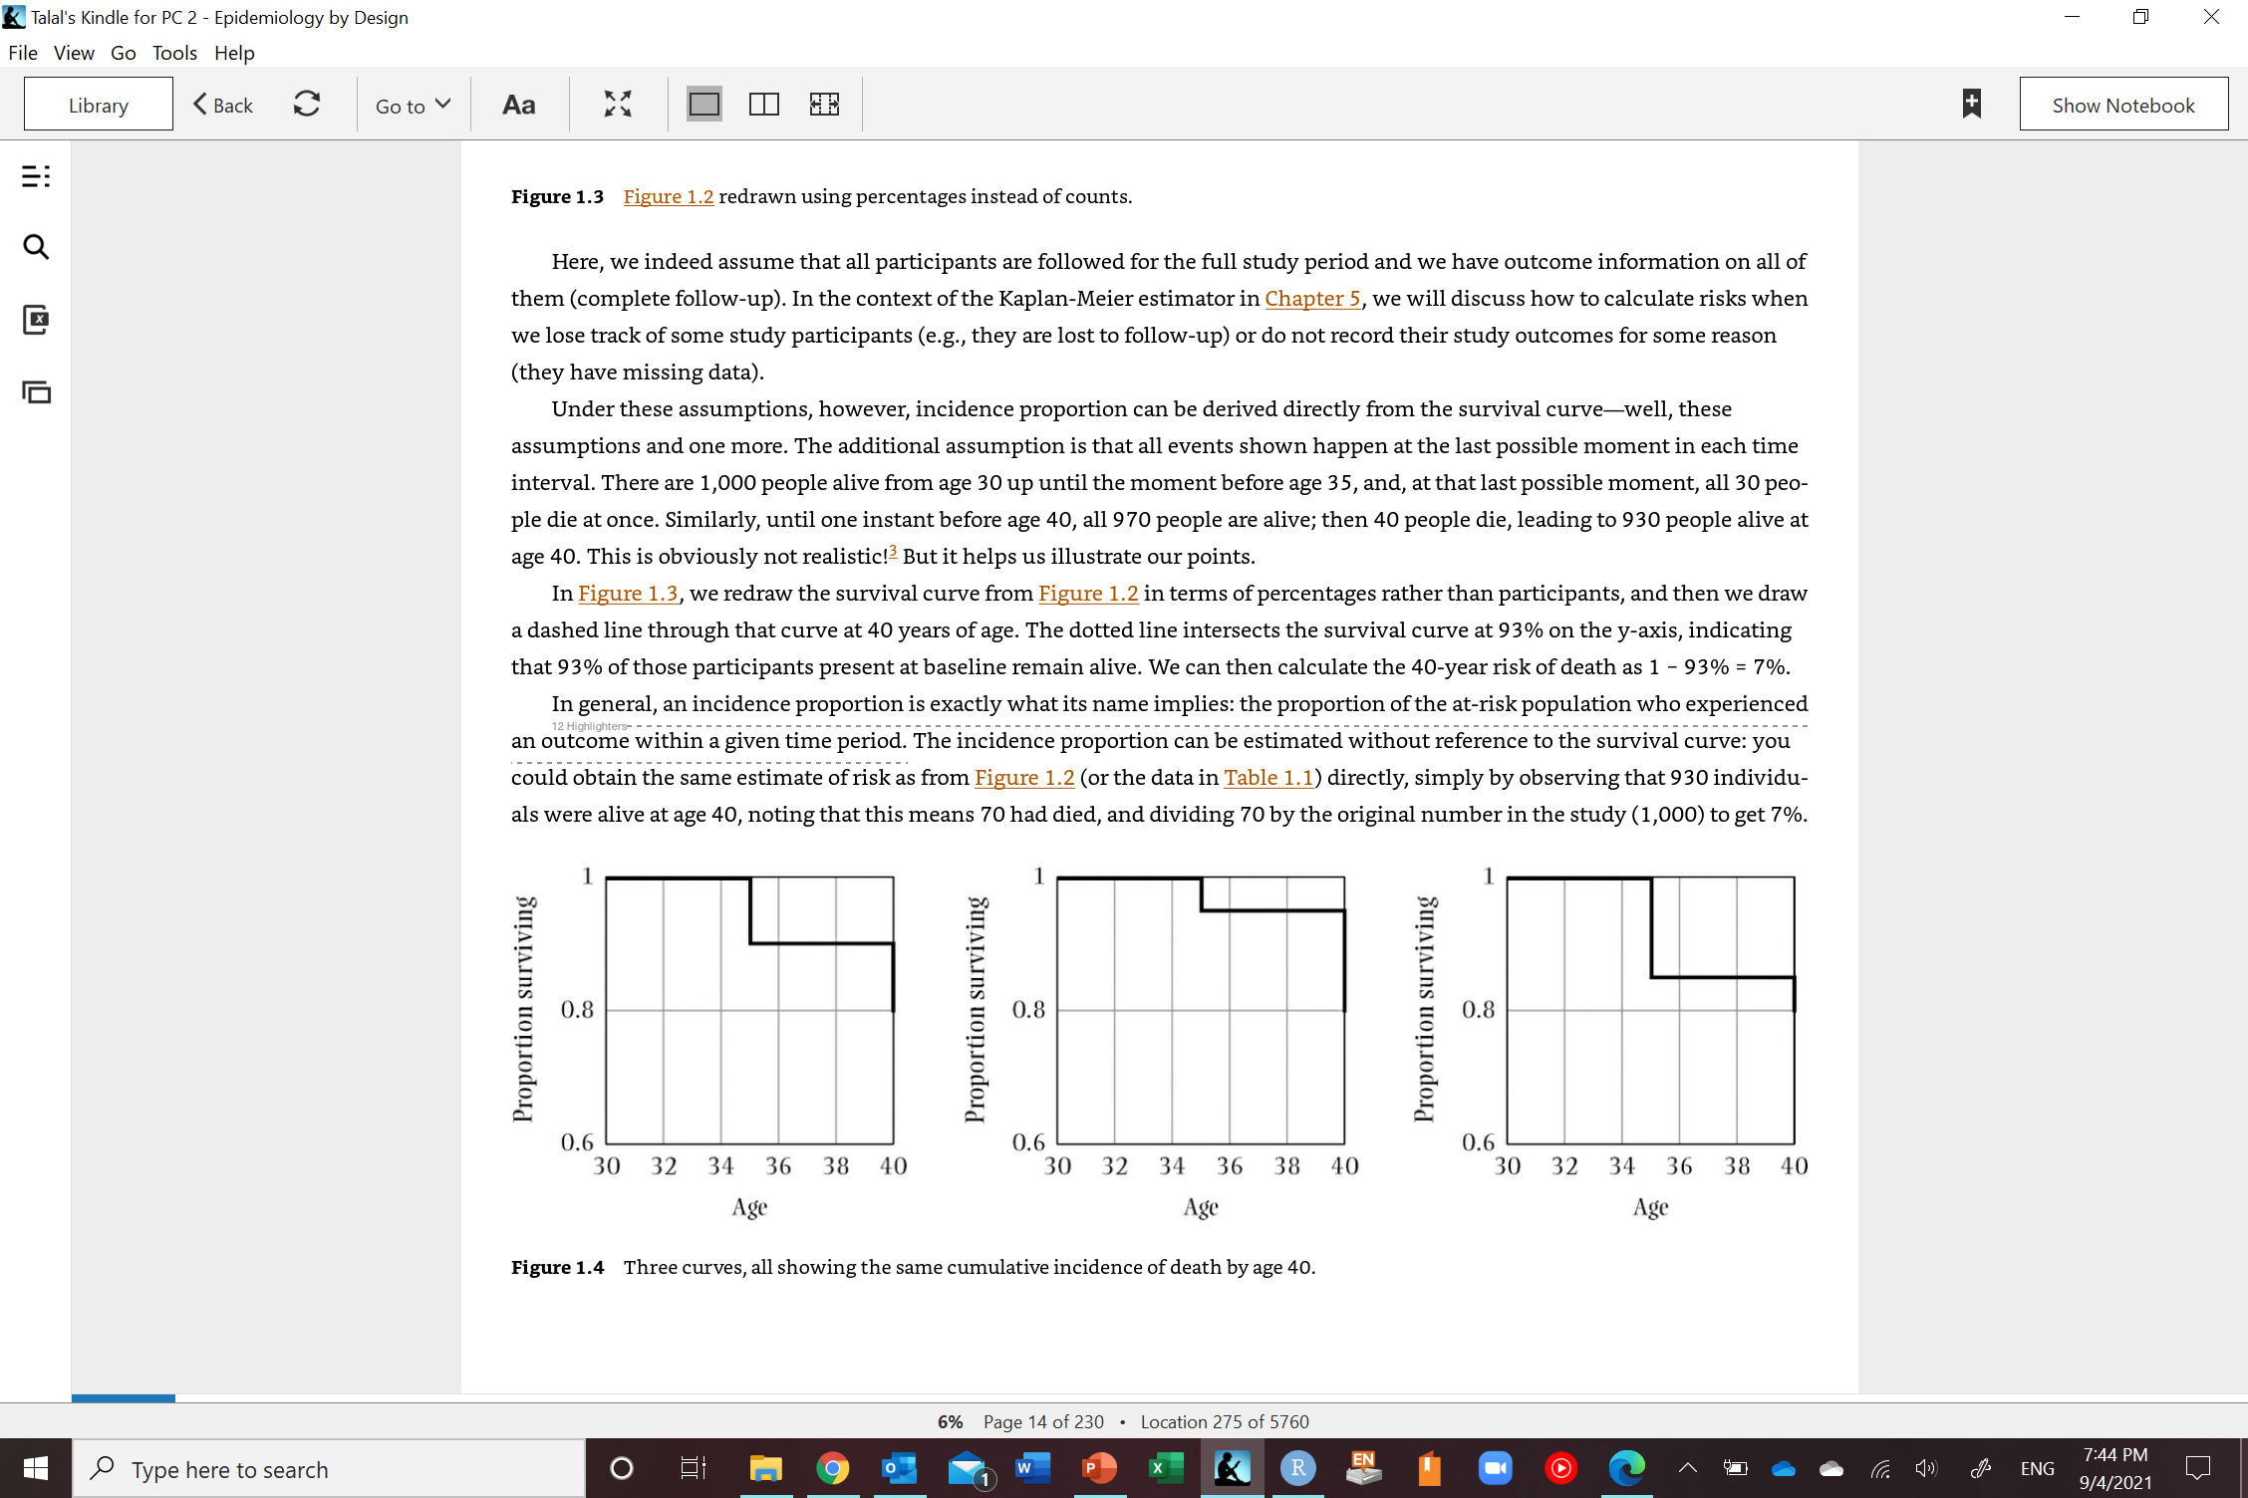
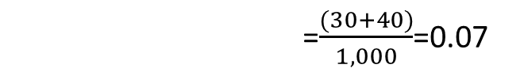
Proportion survived at 40=0.93
Proportion died at 40=1-0.93=0.07
=$\frac{(30+40)}{1,000}$=0.07
$$Incidence proportion(p)=\frac{people at risk that develop outcome in time frame}{total population at risk during time frame}$$
Ranges between 0 to 1 (probability)
Westreich D. Epidemiology by design: a causal approach to the health sciences. Oxford University Press; 2019 Oct 16.
Notes:
Assumptions for incidence proportion:
Fixed period of time (all participants start at the same time and are followed for same amount of time) (instead use incidence rate)
Cannot handle recurrent events (instead use incidence rate)
No competing risks
No loss to follow-up

Slide 49
Assumptions to calculate incidence proportion/cumulative incidence/risk
Everyone complete the follow-up
No one is lost to follow-up
No competing events
Events (death in this case) occur at the end of every interval
For incidence proportion at age 40 we assume all 30 deaths occurred at the last possible moment in the interval 30-35
We also assume all 40 deaths occurred at the last possible moment in the interval 35-40

Slide 50

Incidence proportion and survival
The time matters
All of these populations share the same risk at 40 years but have different survival curves through age 35 (risk at 35)
Westreich D. Epidemiology by design: a causal approach to the health sciences. Oxford University Press; 2019 Oct 16.

Slide 51
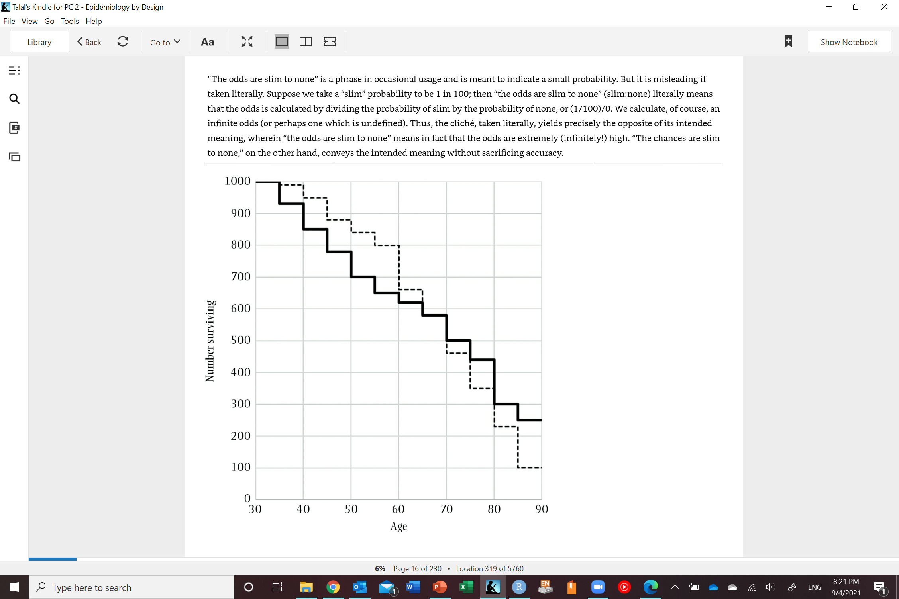
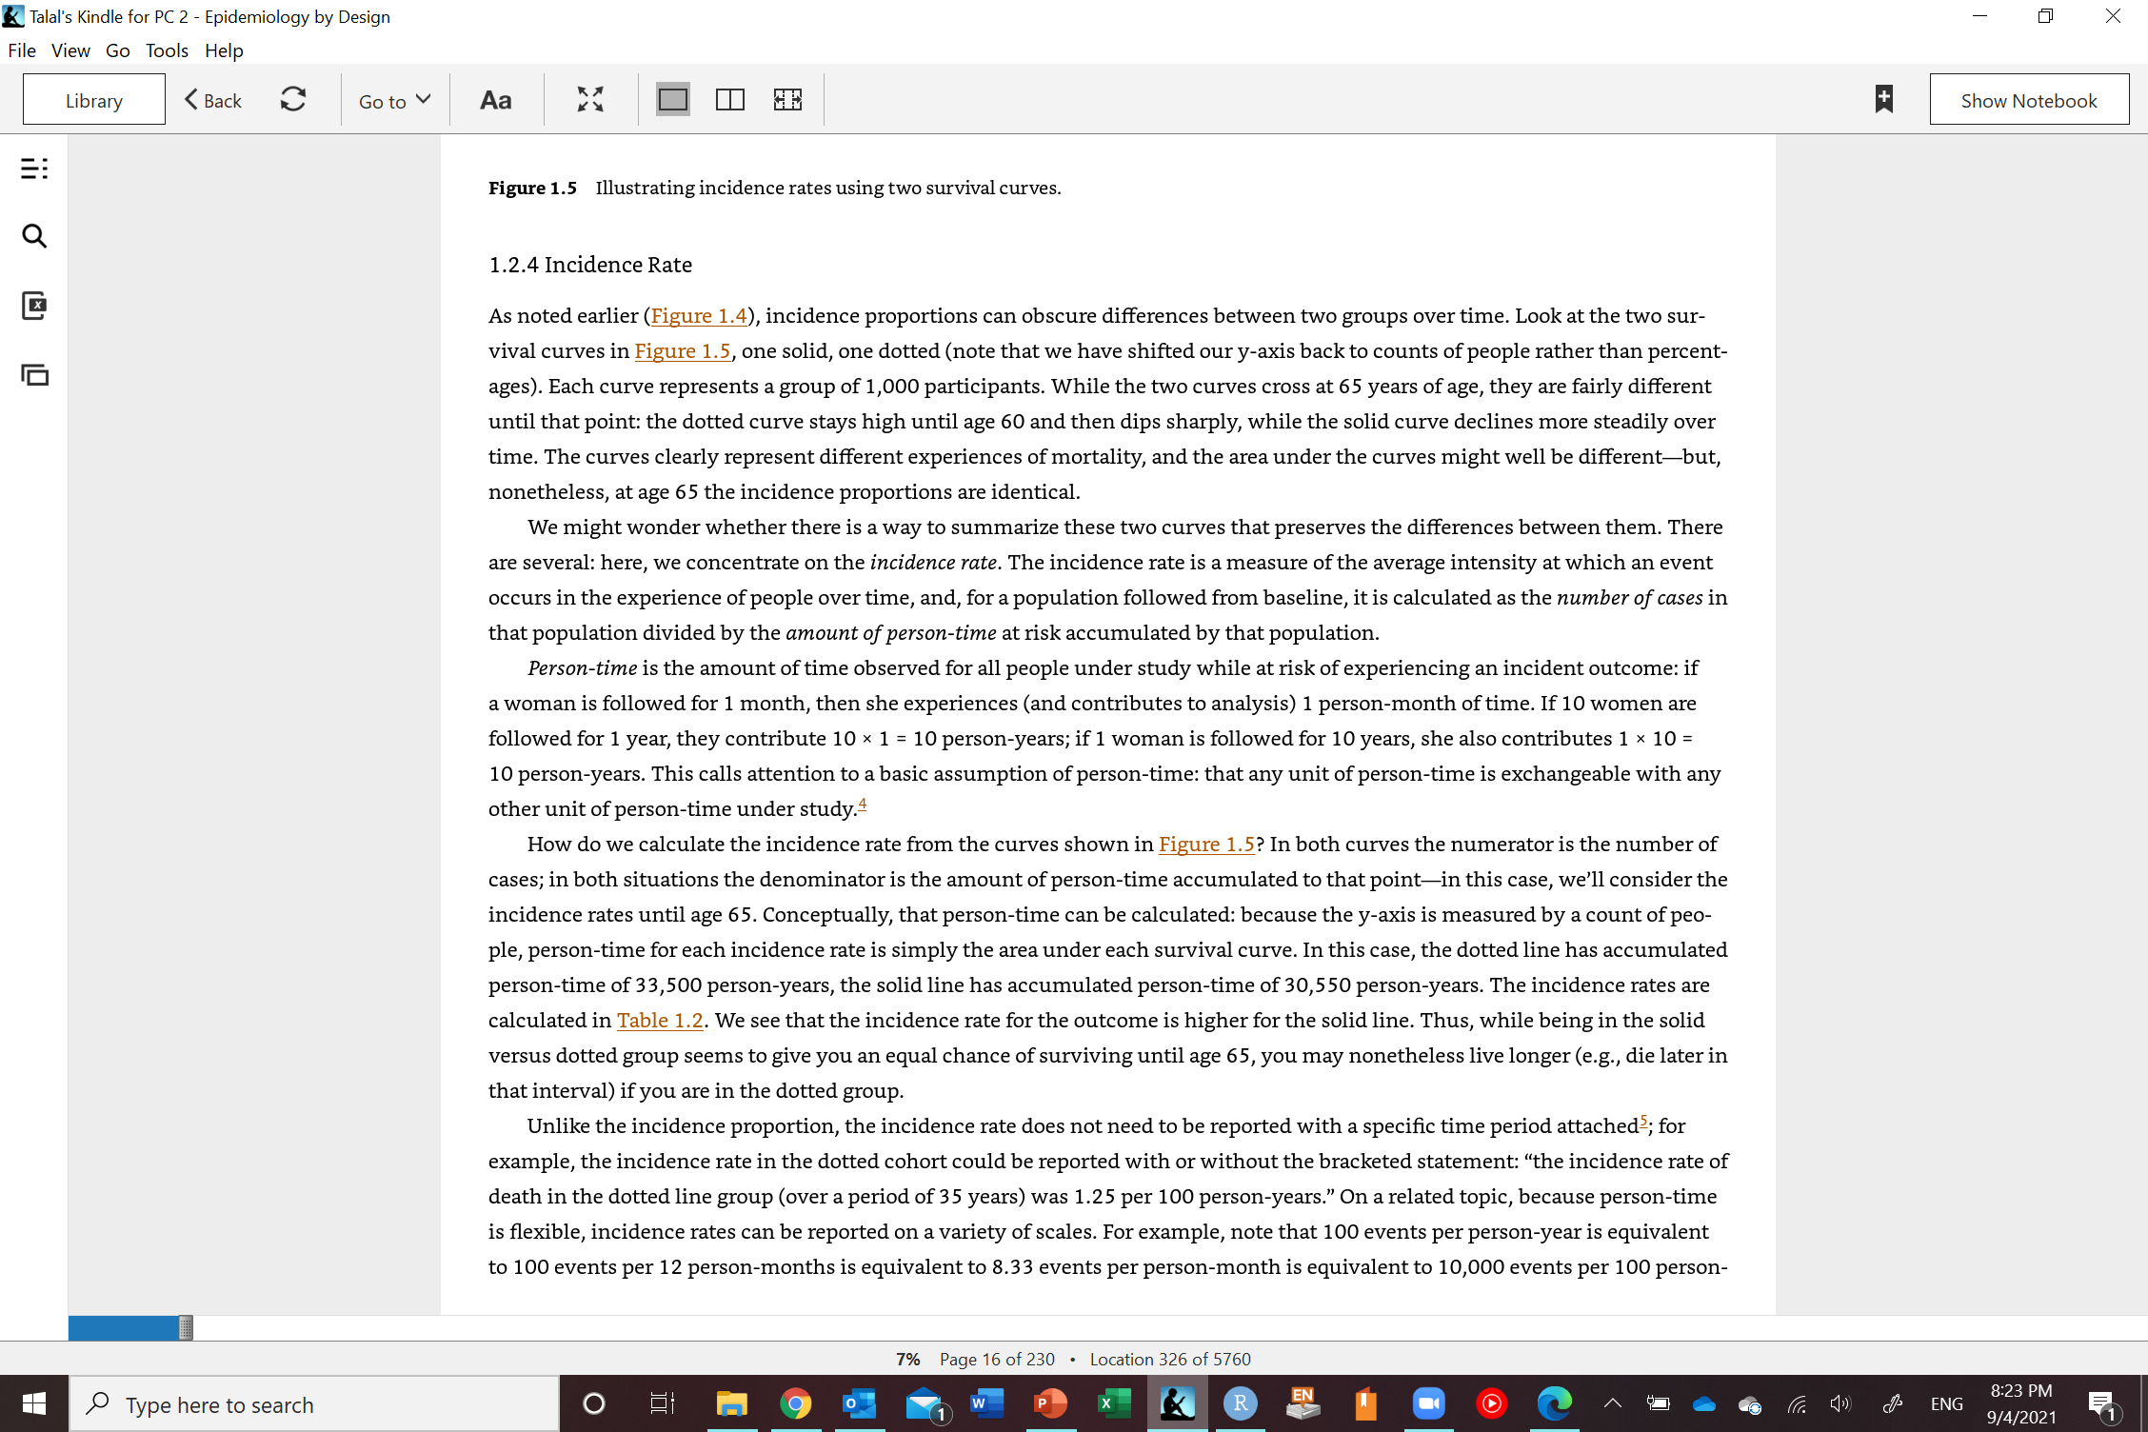
Incidence proportion at 65 for solid line =420/1,000=0.42
Incidence proportion at 65 for dotted line =420/1,000=0.42
Person-time: time contributed by each individual while at risk for developing the outcome
Examples:
One person is followed for 1 year while at risk for death contributes 1 person-year
One person is followed for 10 years while at risk for death contributes 10 person-years
Ten persons each followed for 1 year while at risk for death contribute 10 person-years
Westreich D. Epidemiology by design: a causal approach to the health sciences. Oxford University Press; 2019 Oct 16.

Slide 52
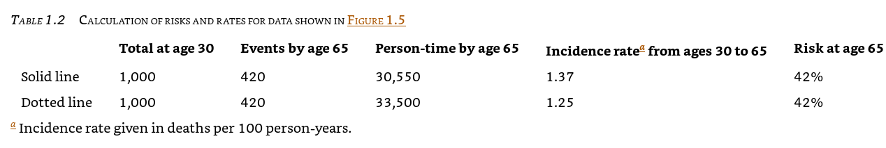
Westreich D. Epidemiology by design: a causal approach to the health sciences. Oxford University Press; 2019 Oct 16.

Slide 53
Issues with incidence proportion
What if people do not complete their follow-up?
What if people die of something else before they have the chance to develop the disease?
We can’t calculate incidence proportion (risk) in this case

Slide 54
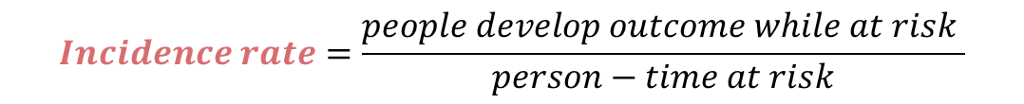
Measures of disease occurrence
Incidence (how many new cases of disease occur over a time period)
$$Incidence rate=\frac{people develop outcome while at risk }{person−time at risk}$$
Ranges between 0 to infinity (not a probability)

Slide 55
Measures of disease occurrence
Incidence (how many new cases of disease occur over a time period)
$$Incidence rate=\frac{people develop outcome while at risk }{person−time at risk}$$
Ranges between 0 to infinity (not a probability)

Slide 56
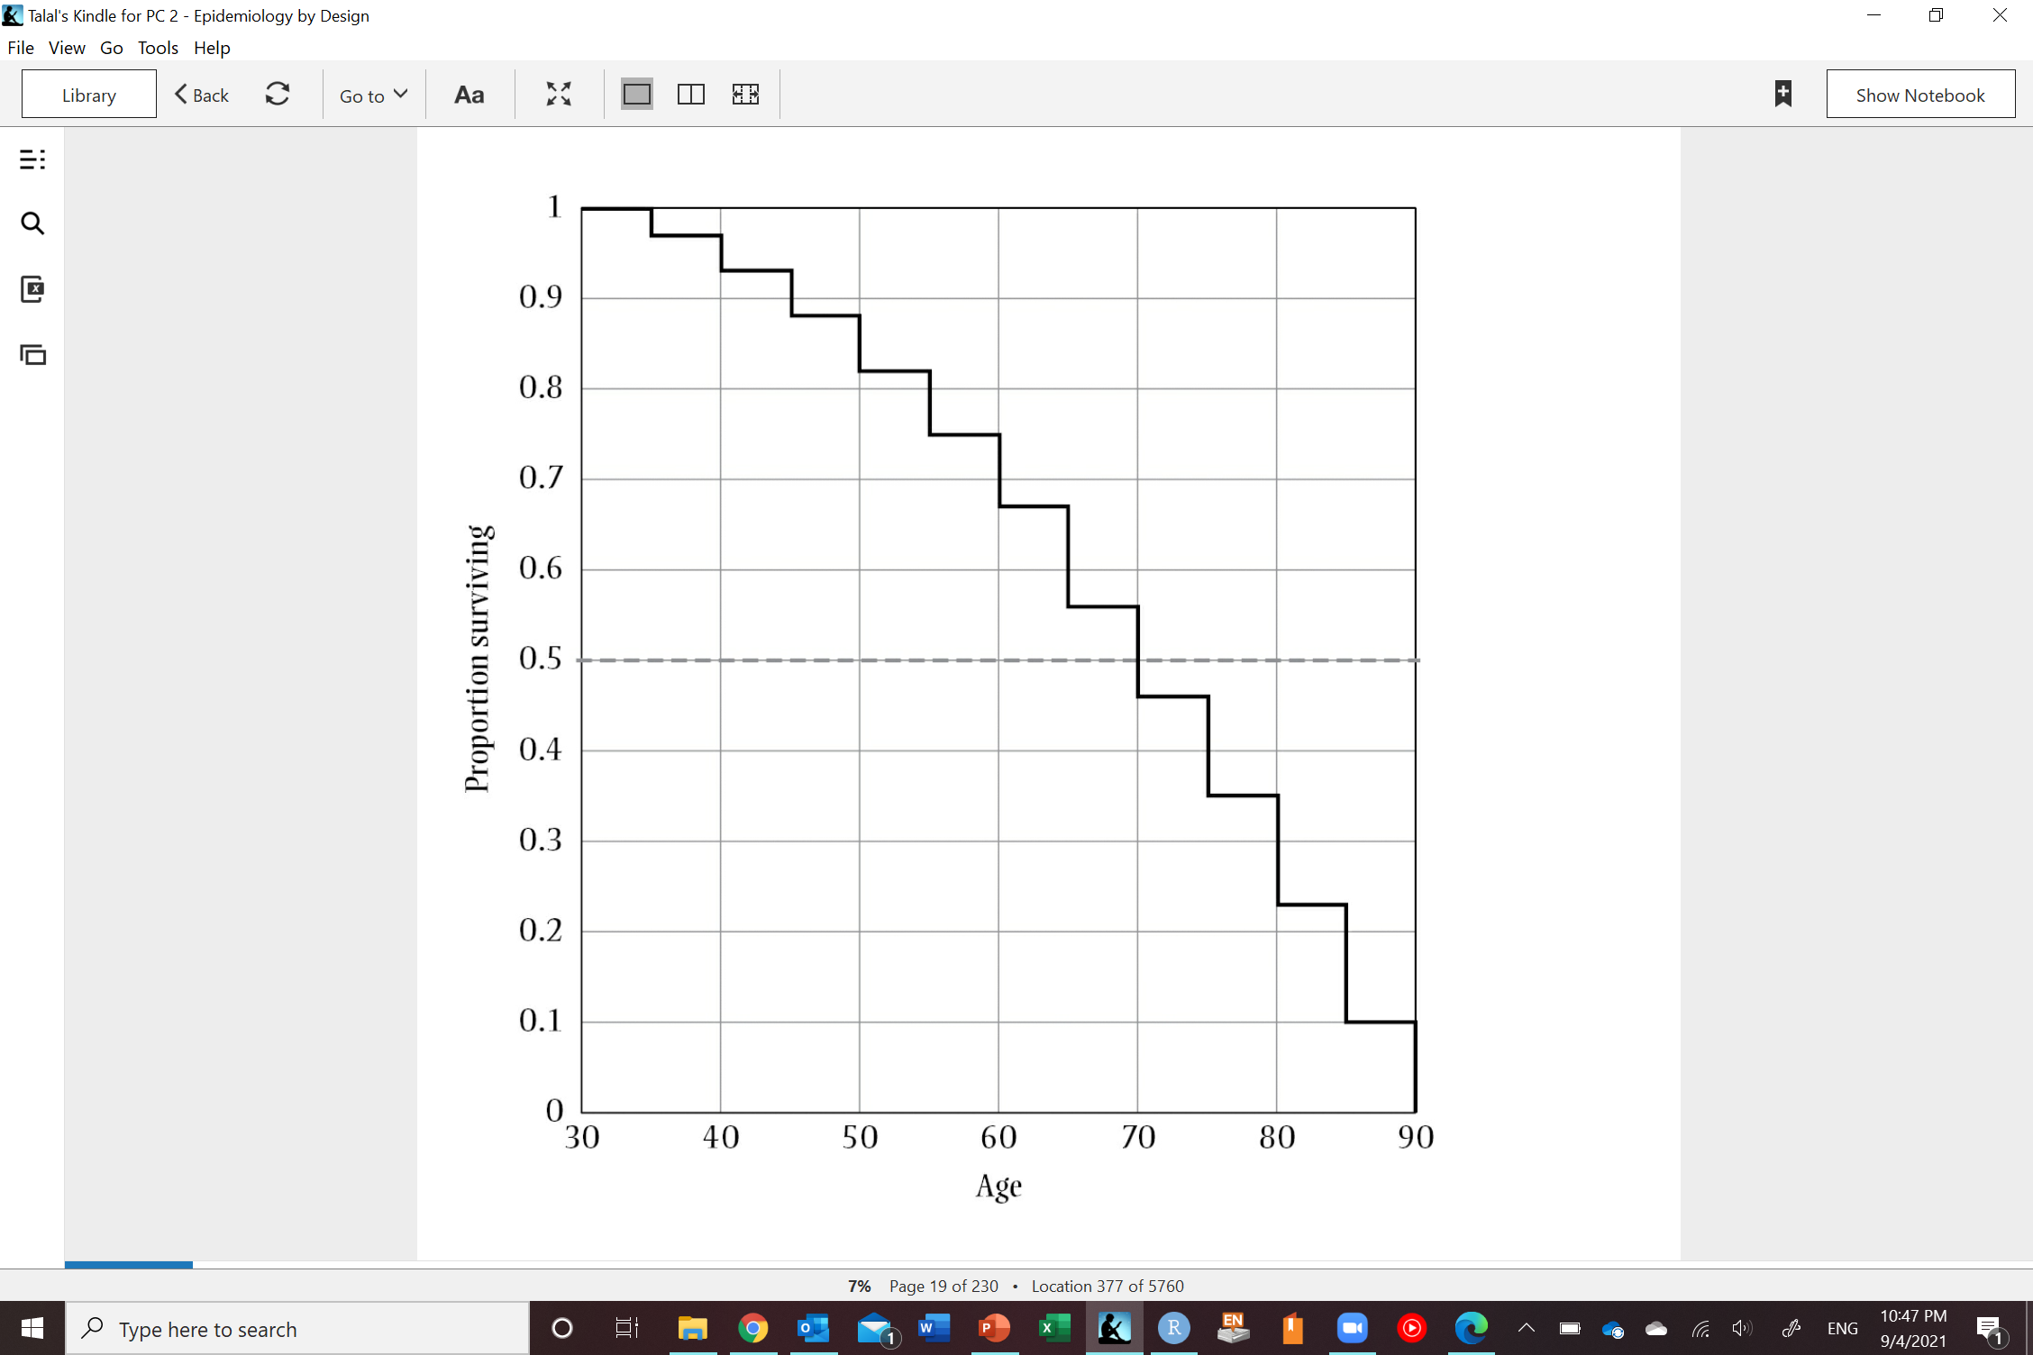
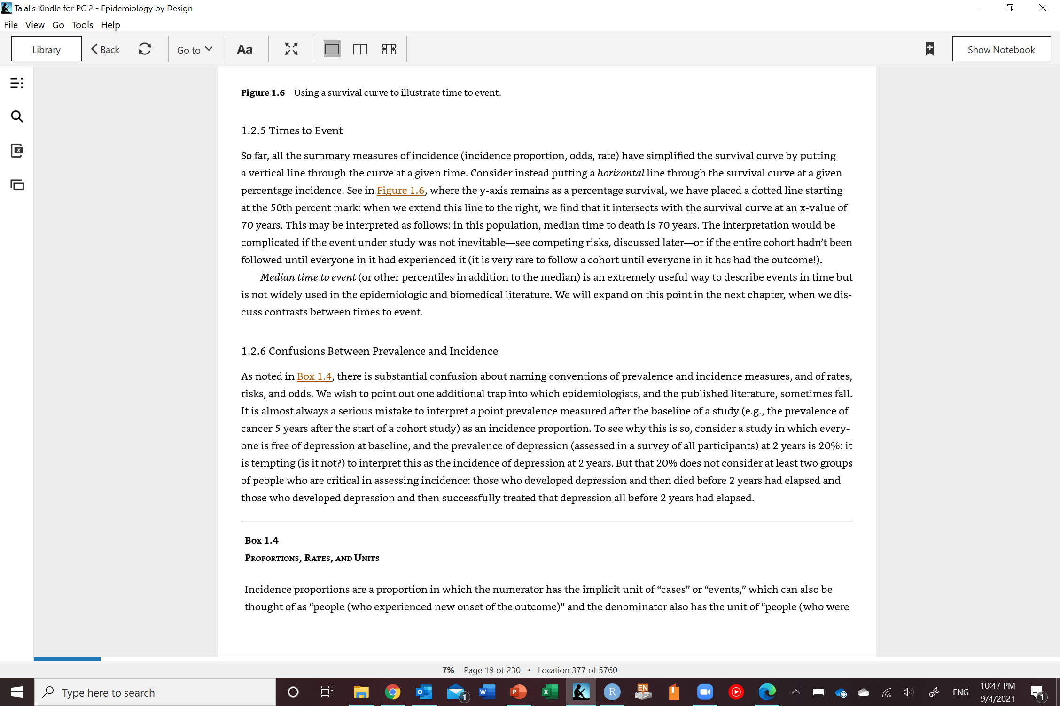
Time to event:
Median time to event (50th percentile)
Other percentiles
Not widely used
When some assumptions are met, average waiting time to event can be interpreted as reciprocal (inverse) of incidence rate (constant incidence rate)
Westreich D. Epidemiology by design: a causal approach to the health sciences. Oxford University Press; 2019 Oct 16.

Slide 57

Measures of disease occurrence
Incidence (how many new cases of disease occur over a time period)
$$Incidence odds=\frac{p}{1−p}$$
Ranges between 0 to infinity (not a probability)
Approximates risk (incidence proportion) if risk < 0.1

Slide 58
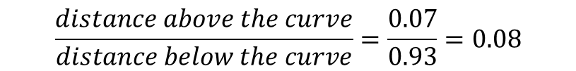
Measures of disease occurrence
Incidence (how many new cases of disease occur over a time period)
0.07
$$Incidence odds=\frac{p}{1−p}$$
0.93
Ranges between 0 to infinity (not a probability)
Approximates risk (incidence proportion) if risk < 0.1
$$Deriving incidence odds from a survival curve$$
$$\frac{distance above the curve}{distance below the curve}=\frac{0.07}{0.93}=0.08$$

Slide 59
Measures of disease occurrence
Incidence (how many new cases of disease occur
over a time period)
Counts (no denominator but context dependent and is known; think COVID)

Slide 60
Measures of disease occurrence
Challenges in calculating incidence measures:
Loss to follow-up (not everybody has complete follow-up)
Competing risks/events (people die before they have a chance to develop outcome (e.g., cardiovascular disease)

Slide 61
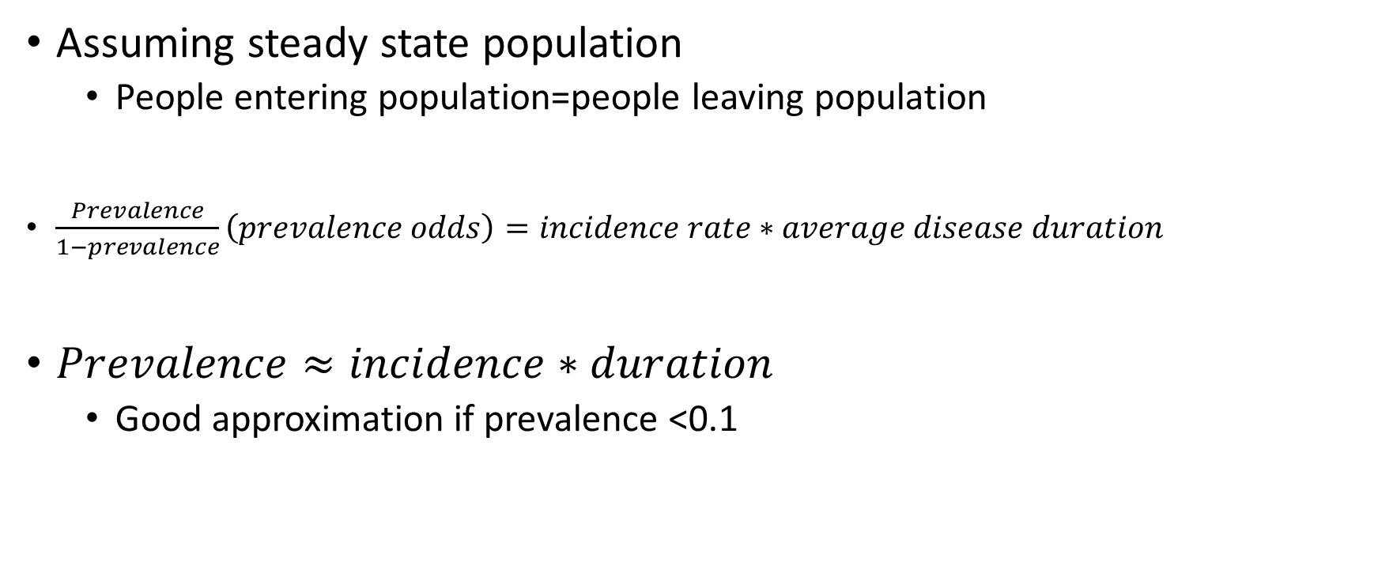
Relation between prevalence and incidence
Assuming steady state population
People entering population=people leaving population
$\frac{Prevalence}{1−prevalence}\left(prevalence odds\right)=incidence rate∗average disease duration$
$Prevalence≈incidence∗duration$
Good approximation if prevalence <0.1

Slide 62
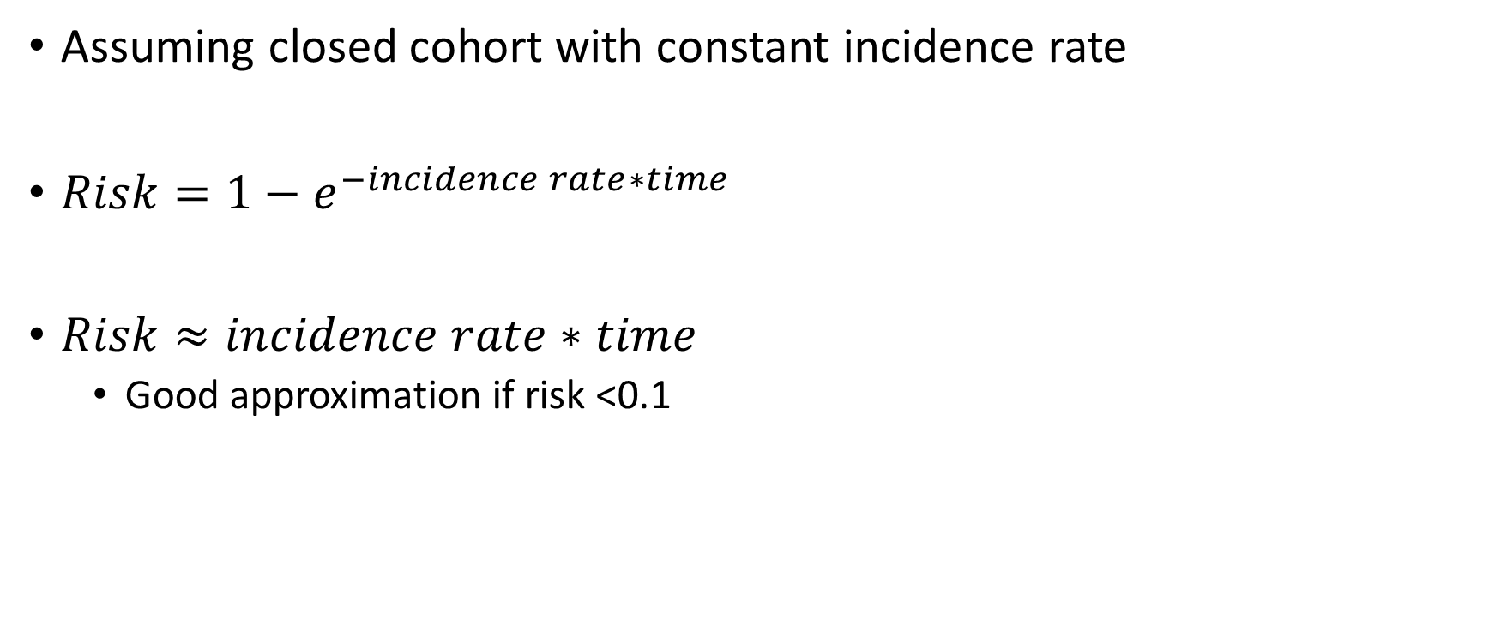
Relation between incidence proportion (risk) and incidence rate
Assuming closed cohort with constant incidence rate
$Risk=1−e^{−incidence rate∗time}$
$Risk≈incidence rate∗time$
Good approximation if risk <0.1

Slide 63
Summary
 | Measure | Range | Time specified | Numerator and denominator | Unit
Prevalence | Proportion | 0 to 1 | Yes | Numerator: people Denominator: people | Unitless
 | Odds | 0 to infinity | Yes | Numerator: people Denominator: people | Unitless
 | Count | 0 to population size | Yes | People | People
Incidence | Proportion | 0 to 1 | Yes | Numerator: people Denominator: people | Unitless
 | Odds | 0 to infinity | Yes | Numerator: people Denominator: people | Unitless
 | Count | 0 to population at risk size | Yes | People | People
 | Rate | 0 to infinity | No | Numerator: people Denominator: people*time | 1/time
 | Time to event | 0 to infinity | No | Numerator: people*time Denominator: people | time

Slide 64
Any Questions?
shihaybt@ksau-hs.edu.sa

